Slide 1

Critical Opportunities for Public Health Law:
Title: Presentation Title Goes Here
Name: Name Goes Here Institution: Name Goes Here

Slide 2

A Problem
  Please describe the scale of the problem — the burden of disease defined in terms of prevalence, severity, disability or disparities.
  Citations are not required.

Slide 3

Where Does Law Fit In?
  Please briefly explain how a new law (or a change in an existing law) would solve or lessen the problem.

Slide 4
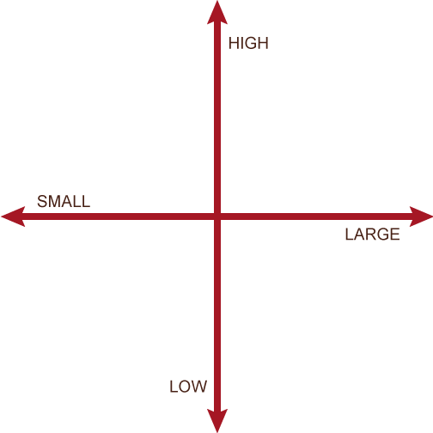

Evidence Supporting the Reform
  Please use this space to briefly share any evidence that supports using the intervention. For example:
  Studies of this kind of law
  Studies of similar laws
  Experiences reported from places where this law has been used
  Use the Evidence Axis (left) to plot the strength of the evidence and the magnitude of the effect we can expect the law to have.
Strength of Evidence
Magnitude
of Effect
Place this dot representing your legal intervention on the axis above

Slide 5
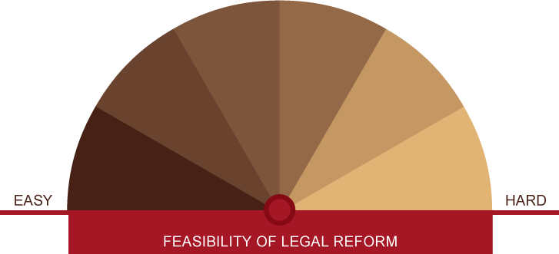

A Way Forward
  How feasible is the intervention in terms of the political environment, legal issues, and cost? Move the hand on the dial above to show the feasibility of enacting your proposal, and use this space for your comments on barriers or facilitators.

